Slide 1
SmartPay AP
Agentic AI Platform for Invoice Reconciliation
Acme Manufacturing · 25 countries · 1M invoices/month
AI Architect Case Study — Akhil Ahmed — May 2026

Slide 2
The Business Problem
Acme processes 1M invoices/month manually — it doesn't scale
1M+
3–5 days
2–3%
$2M+
invoices / month
manual cycle time
error rate
monthly exposure
Current State
SmartPay AP Delivers
• Finance manually checks every invoice vs PO and GRN
• No pattern detection — same vendor errors repeat monthly
• 25 countries, 4 currencies, 2 ERPs — no unified view
• GDPR compliance not enforced at data ingestion
• Automated invoice-to-PO-to-GRN reconciliation
• Real-time mismatch detection with explainable reasons
• LLM drafts vendor dispute emails via MCP tools
• Human approves every action — no autonomous payments

Slide 3
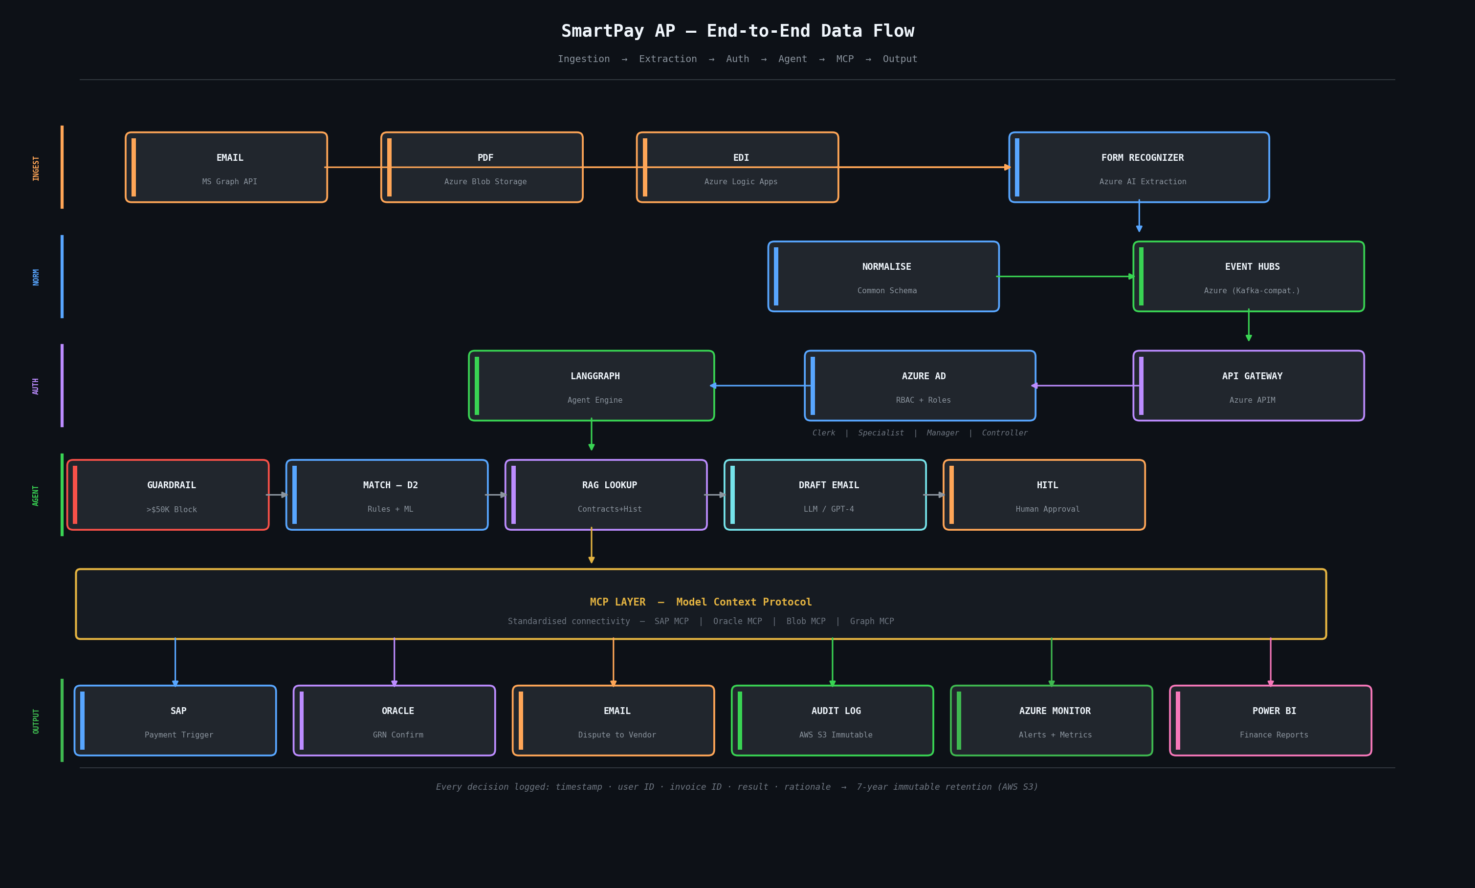
End-to-End Data Flow
From invoice arrival to payment or dispute — every step shown

Slide 4
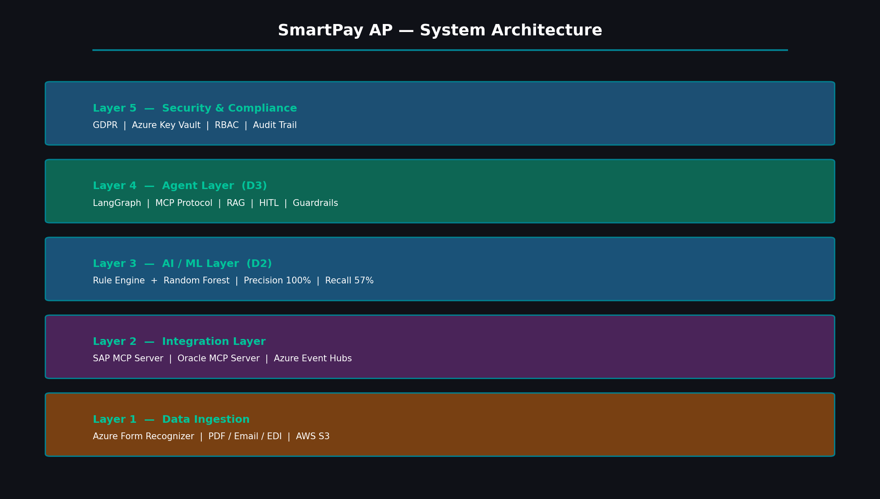
Solution Architecture — 5 Layers

Slide 5
Data Ingestion Layer
Three input channels — all normalised to common schema before processing
Email (MS Graph API)
PDF (Azure Blob / SFTP)
EDI (Azure Logic Apps)
• Graph API monitors AP inbox 24/7
• New email triggers event automatically
• PDF attachment saved to Azure Blob
• Form Recognizer extracts structured data
• Vendor uploads PDF to supplier portal
• Azure Data Factory detects new file
• Form Recognizer reads and extracts fields
• Data normalised to common invoice schema
• Vendor ERP sends X12/EDIFACT directly
• Logic Apps receives at EDI endpoint
• Fields mapped to common schema
• No Form Recognizer needed — already structured
All three channels produce same output: normalised invoice → Azure Event Hubs → LangGraph agent

Slide 6
Matching Model — D2
Two-layer design: rules for explainability, ML for edge cases
Layer 1 — Rule-Based Engine
Layer 2 — Random Forest (scikit-learn)
• Quantity mismatch: invoice qty != PO qty
• Price mismatch: deviation > 1% from PO price
• GRN not received: goods receipt qty = 0
• Duplicate invoice: same ID submitted twice
• Item not in PO: item code not on order
• Currency mismatch: invoice != PO currency
• 13 features: qty delta %, price delta %, GRN gap
• Random Forest — 100 trees, balanced class weights
• Trained on 1,200 labeled examples (80/20 split)
• Why RF: interpretable, fast, feature importance for audit
• Why not XGBoost: RF gives cleaner audit trail
Accuracy
89%
Precision (MISMATCH)
100%
Recall (MISMATCH)
57%
False Positive Rate
0%
Design choice: 100% precision — every flag is actionable. 57% recall is intentional — false positives cost more in AP.

Slide 7
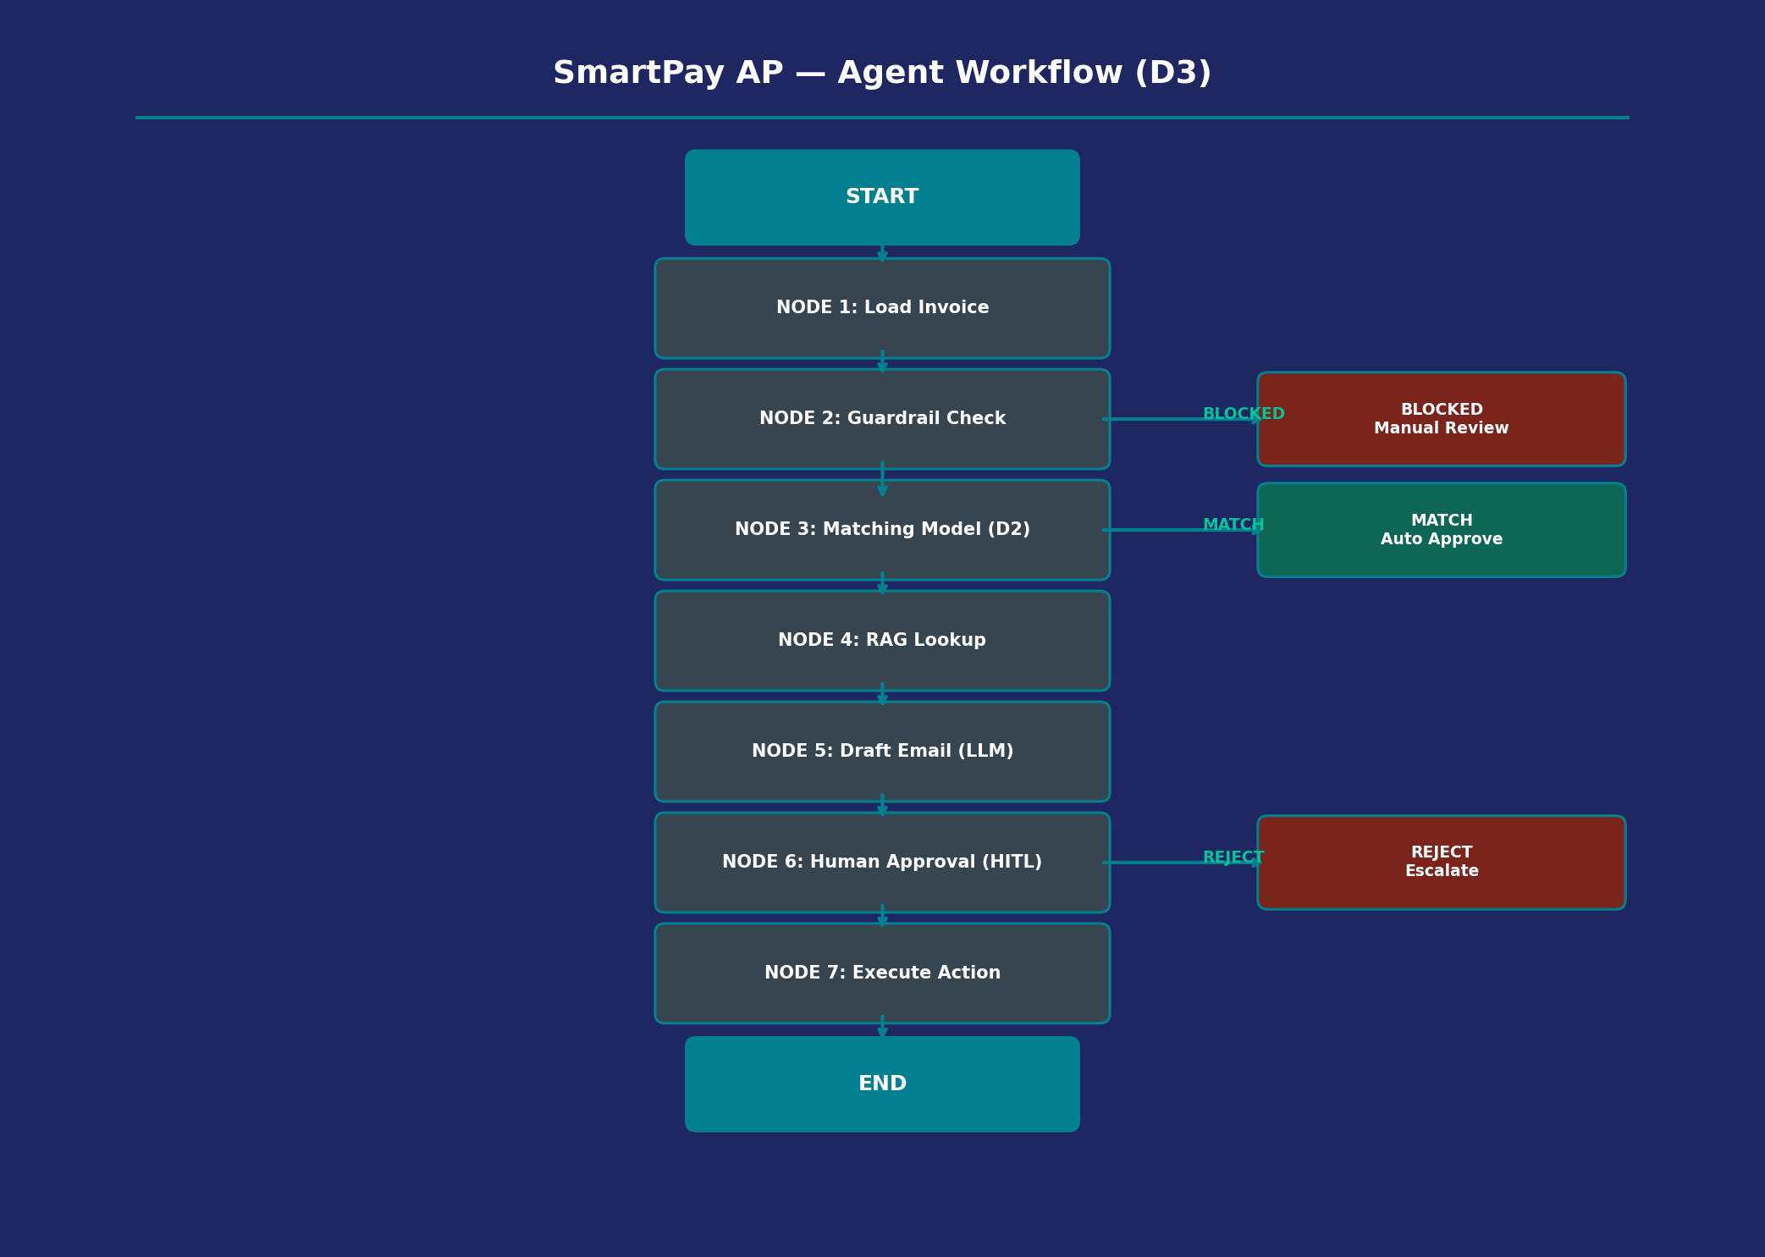
Agentic Workflow — D3 (LangGraph)
7-node deterministic workflow with RAG, HITL, MCP and guardrails
Why LangGraph?
• Deterministic — exact node sequence
• Native HITL — pause built in
• Auditable — every step logged
• Not CrewAI — better for fixed AP workflow
Key Guardrails
• Invoices > $50K blocked automatically
• Input validation on all tool calls
• No autonomous payment actions
• Rate limiting on LLM calls

Slide 8
ERP Integration — SAP & Oracle via MCP
SAP Integration
Oracle Integration
• SAP MCP Server exposes BAPI/RFC endpoints
• PO lookup: ME23N transaction via BAPI
• GRN lookup: MIGO/MIRO transaction BAPIs
• Payment trigger: SAP FI module (F-53)
• Auth: SAP service user, minimum permissions
• Agent calls SAP via MCP — no custom connector
• Oracle MCP Server exposes REST endpoints
• PO: /fscmRestApi/resources/purchaseOrders
• GRN: /fscmRestApi/resources/receivingReceipts
• Auth: OAuth 2.0 with token refresh
• Rate-limited with exponential backoff
• Agent calls Oracle via MCP — same protocol as SAP

Slide 9
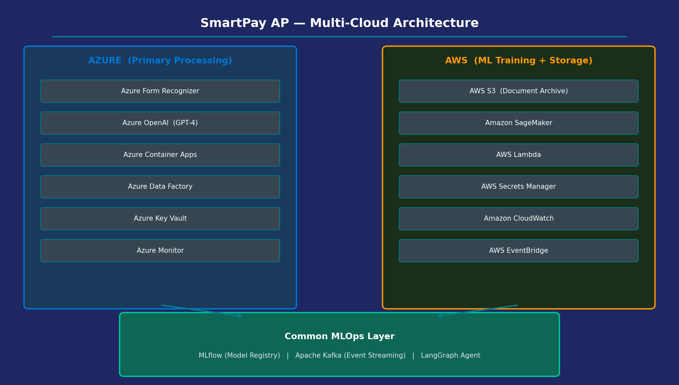
Multi-Cloud Architecture — Azure + AWS

Slide 10
Security, Access Control & GDPR
Access Control (RBAC)
Audit Trail
Azure AD — 4 roles: AP Clerk (view), Specialist (approve <$10K), Manager (approve <$50K), Controller (approve any). Enforced at API Gateway before reaching agent.
Every agent decision logged: timestamp, user ID, invoice ID, result, rationale. Immutable in AWS S3. 7-year retention.
Data Privacy (GDPR)
Data Residency
PII encrypted at rest (AES-256) and in transit (TLS 1.3). EU invoices stay in Azure West Europe. GDPR Art. 44.
EU invoices processed only in Azure West Europe. Never leaves EU boundary. Right to erasure in 30 days.
Secrets Management
Model Governance
Azure Key Vault for all credentials. SAP/Oracle passwords never in code or environment variables.
All predictions logged. Bias monitoring by vendor, currency, country. Auto-alert if model drifts.

Slide 11
Responsible AI — D4 Summary
Bias Detection
Explainability
Flag rates monitored weekly by vendor, country, currency. Alert if any segment flagged >3x average rate.
Every mismatch shows which rule triggered and top ML feature. Finance team always knows why invoice was flagged.
Human Oversight
Model Monitoring
No payment or email sent without human approval. HITL is hardcoded — not configurable.
Precision/recall tracked weekly in MLflow. Auto-retrain if precision drops below 95%.
Guardrails
Data Minimisation
High-value invoices (>$50K) always manual. Input validation on all MCP tool calls.
Only matching features used in training. No vendor identity or payment history in ML model.

Slide 12
Tech Stack — What We Actually Built vs Production
Built & Tested (MVP)
Production Architecture
• Python 3.11
• pandas 2.2.2 — data manipulation
• numpy 1.26.4 — numerical operations
• scikit-learn 1.5.0 — Random Forest model
• matplotlib 3.10.9 — feature importance chart
• LangGraph 0.1.5 — agent workflow
• LangChain 0.2.5 — LLM abstraction
• OpenAI 1.30.5 — GPT-4 email drafting
• Jupyter — D2 notebook
• Azure Form Recognizer — PDF extraction
• Azure Event Hubs — Kafka-compatible streaming
• Azure API Management — gateway + auth
• Azure AD — RBAC access control
• Azure Container Apps — agent hosting
• Azure Key Vault — secrets
• AWS S3 — immutable audit logs
• Amazon SageMaker — ML training at scale
• MCP Protocol — SAP/Oracle connectivity
• MLflow — model registry + monitoring

Slide 13
Trade-offs & Design Decisions
LangGraph over CrewAI
Rules + Random Forest over Neural Networks
AP reconciliation is a fixed sequential workflow. LangGraph gives deterministic control and native HITL. CrewAI suits autonomous multi-agent tasks — not this use case.
Rules are explainable — auditors need clear reasons for every flag. RF catches subtle patterns rules miss. Neural nets are black-box and overkill for tabular AP data.
RAG over Fine-tuning
MCP over Custom Connectors
Vendor contracts change frequently. RAG retrieves latest data without retraining. Fine-tuning becomes stale after every contract update.
MCP gives standardised connectivity to SAP, Oracle, and Azure. Adding a new system = deploy new MCP server. No agent code changes needed.

